Slide 1
Lecture 4 Conducting Reproducible Research
Dr Andy MacLachlan
Centre for Advanced Spatial Analysis
October 2021
VEVOX ID: 186-395-009
PLEASE SIGN IN BEFORE YOU LEAVE

Slide 2
Last week review
Deal with coordinate reference systems
List files in folders
Know how rasters are stacked
Able to extract data from rasters for analysis
Plot histograms

Slide 3
Some common Qs
Difference between a stack and a brick
the main difference is that a RasterStack is loose collection of RasterLayer objects that can refer to different files (but must all have the same extent and resolution), whereas a RasterBrick can only point to a single file.
https://rspatial.org/raster/spatial/4-rasterdata.html
This means would could use a brick to read in the files from last week, but if they were individual we would need to use stack
We could convert – raster::brick()

Slide 4
Some common Qs
Raster developments
stars package – works with sf and sf functions, not well documented
terra – works with files that can be stored on disc and not in RAM + makes classes – SpatRaster
There isn’t a clear raster winner at the moment

Slide 5
Some common Qs
The benefit of listing files
You can stack them from the list you get – as opposed to reading them all in and then stacking
Account for any future file name changes

Slide 6
Some common Qs
Difference between sp (2005) and sf (2016)
intuitive data structures sp data, like the SpatialPolygonsDataframe were composed of lists inside lists and were quite hard to decompose (there was a good reason why it was coded like this, but I forget why).
sf objects are just data-frames that are collections of spatial objects. Each row is a spatial object (e.g. a polgyon), that may have data associated with it (e.g. its area) and a special geo variable that contains the coordinates.
https://www.r-bloggers.com/2018/03/should-i-learn-sf-or-sp-for-spatial-r-programming/
Easier to use sf with tidyverse

Slide 7
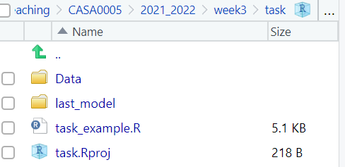
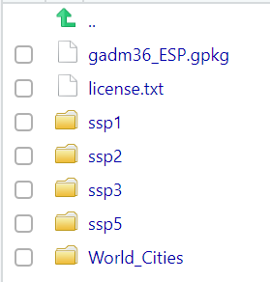
Some common Qs
The here package
Struggling to load data that is within your project folder?
Here starts at your project folder…so if data is in your project folder it’s just…
world_cities <- st_read(here( "World_cities.shp"))
Within a data folder and world_cities folder
world_cities <- st_read(here("Data", "World_Cities", "World_cities.shp"))

Slide 8
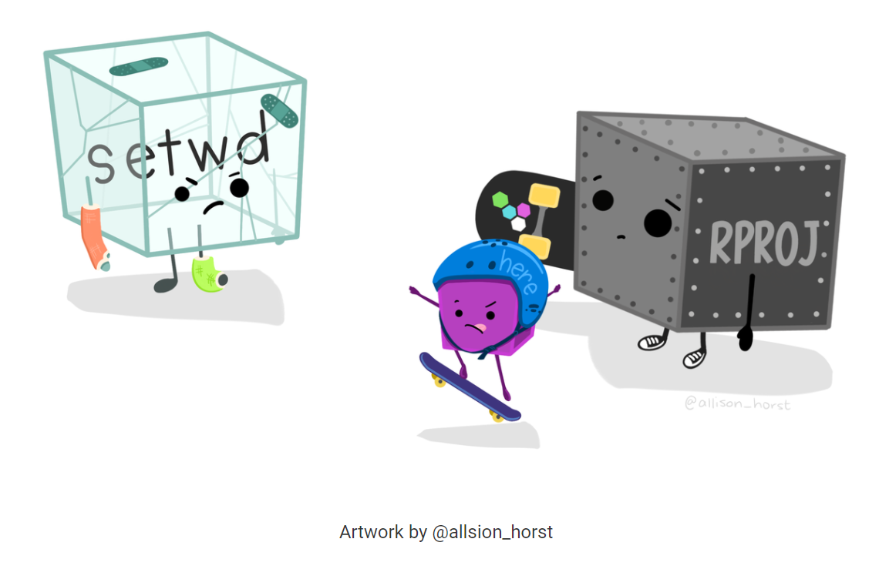
Some common Qs
Do not use setwd()!
Exam – we can’t reproduce.
Ideally don’t use file paths, use here – cross operating system compatible.
Comment your code with #

Slide 9
Some common Qs
Why didn’t we need to project our data?
Should you have used a local Spanish CRS?

Slide 10
Some common Qs
Why didn’t we need to project our data?
Should you have used a local Spanish CRS?
Didn’t need to as it was just data from points
I could have done it
If I was producing a map or doing any spatial statistics (in future weeks) then yes it was essential

Slide 11

Have you used Git or GitHub before
POLL OPEN
1.
No
35.42%
2.
Git
2.08%
3.
GitHub
33.33%
4.
Both
29.17%
Join: vevox.app ID: 186-395-009
Vote Trigger

Slide 12
But why
From rOpenSci
“The aim of practising reproducible computational research is to expose more of the research workflow to our audience. This makes it easier for them to make a more informed assessment of our methods and results, and makes it easier for them to adapt our methods to their own research.”
http://ropensci.github.io/reproducibility-guide/sections/introduction/

Slide 13
Everytime i read a paper / article / some research
Join: vevox.app ID: 186-395-009
POLL OPEN
1.
I could easily do what they did
2
2.
I could probably do it with a bit of work
6
3.
I'd have to make some assumptions
9
4.
It would take me a long time to work it out
27
5.
No way
4
Vote Trigger

Slide 14
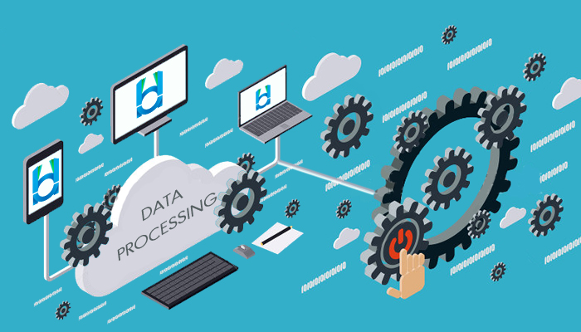


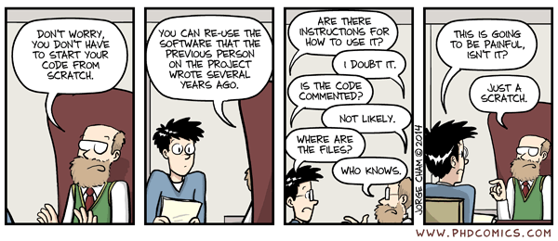
The past

Slide 15
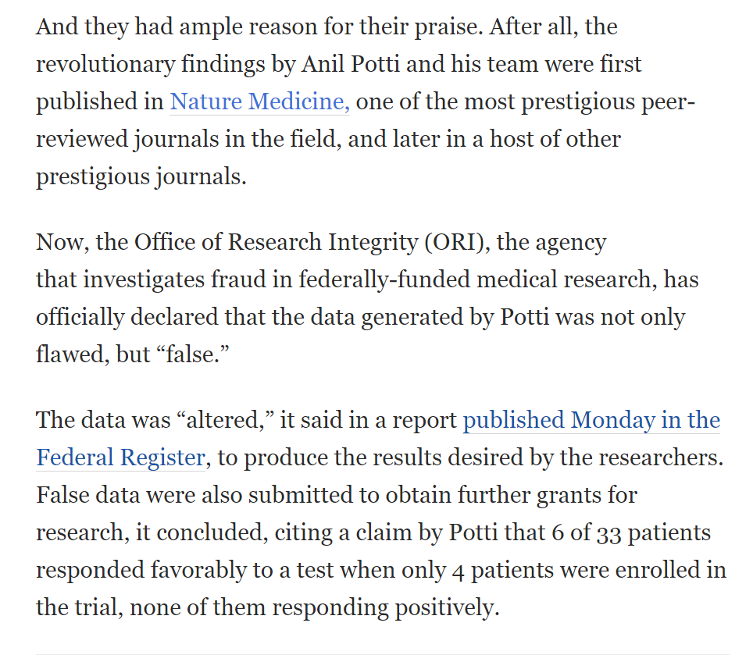
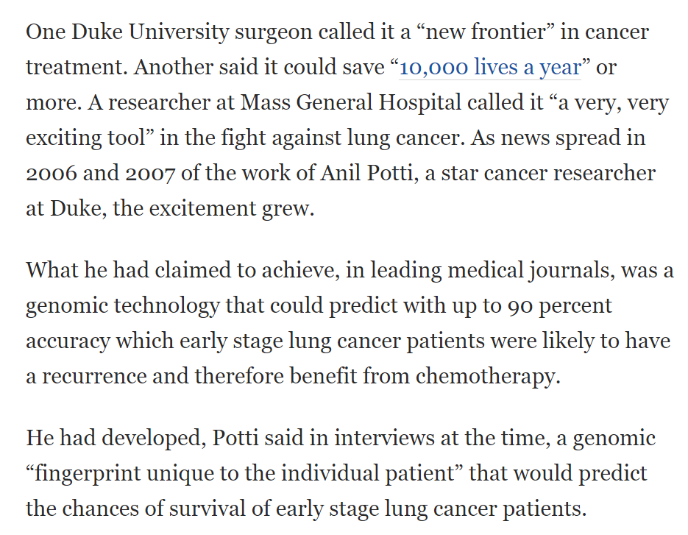
the Duke/Potti scandal
Source: the Washington post, see https://www.youtube.com/watch?v=7gYIs7uYbMo&t=328s

Slide 16


Slide 17

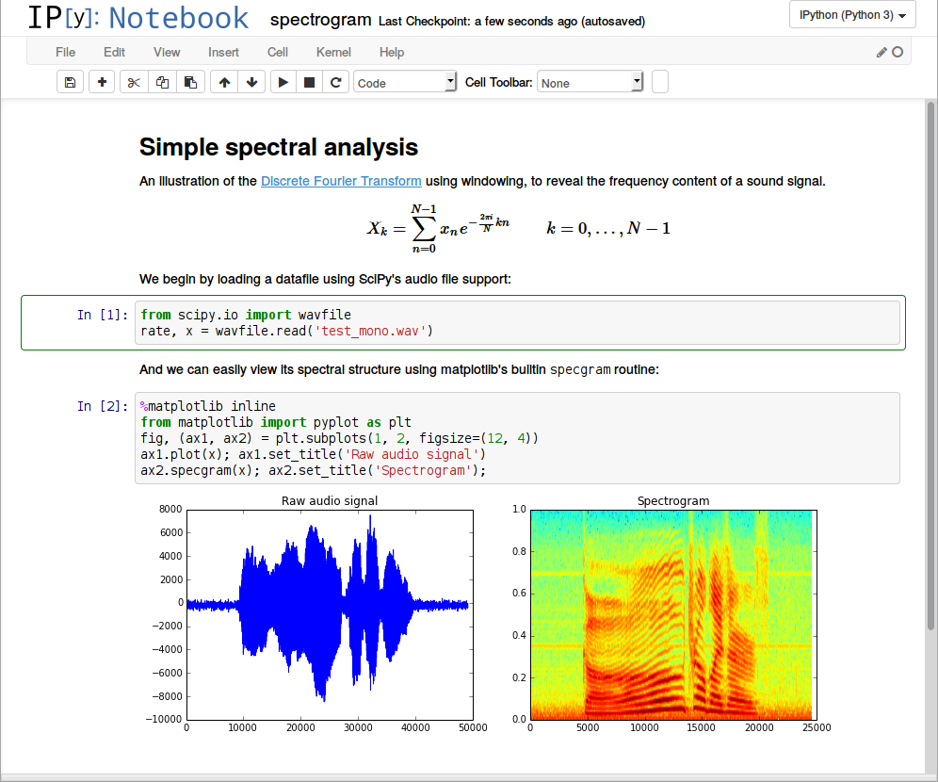
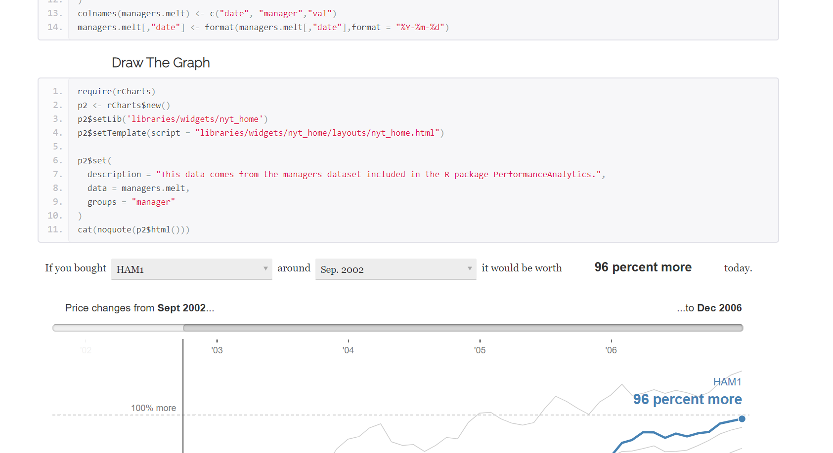
The future…

Slide 18
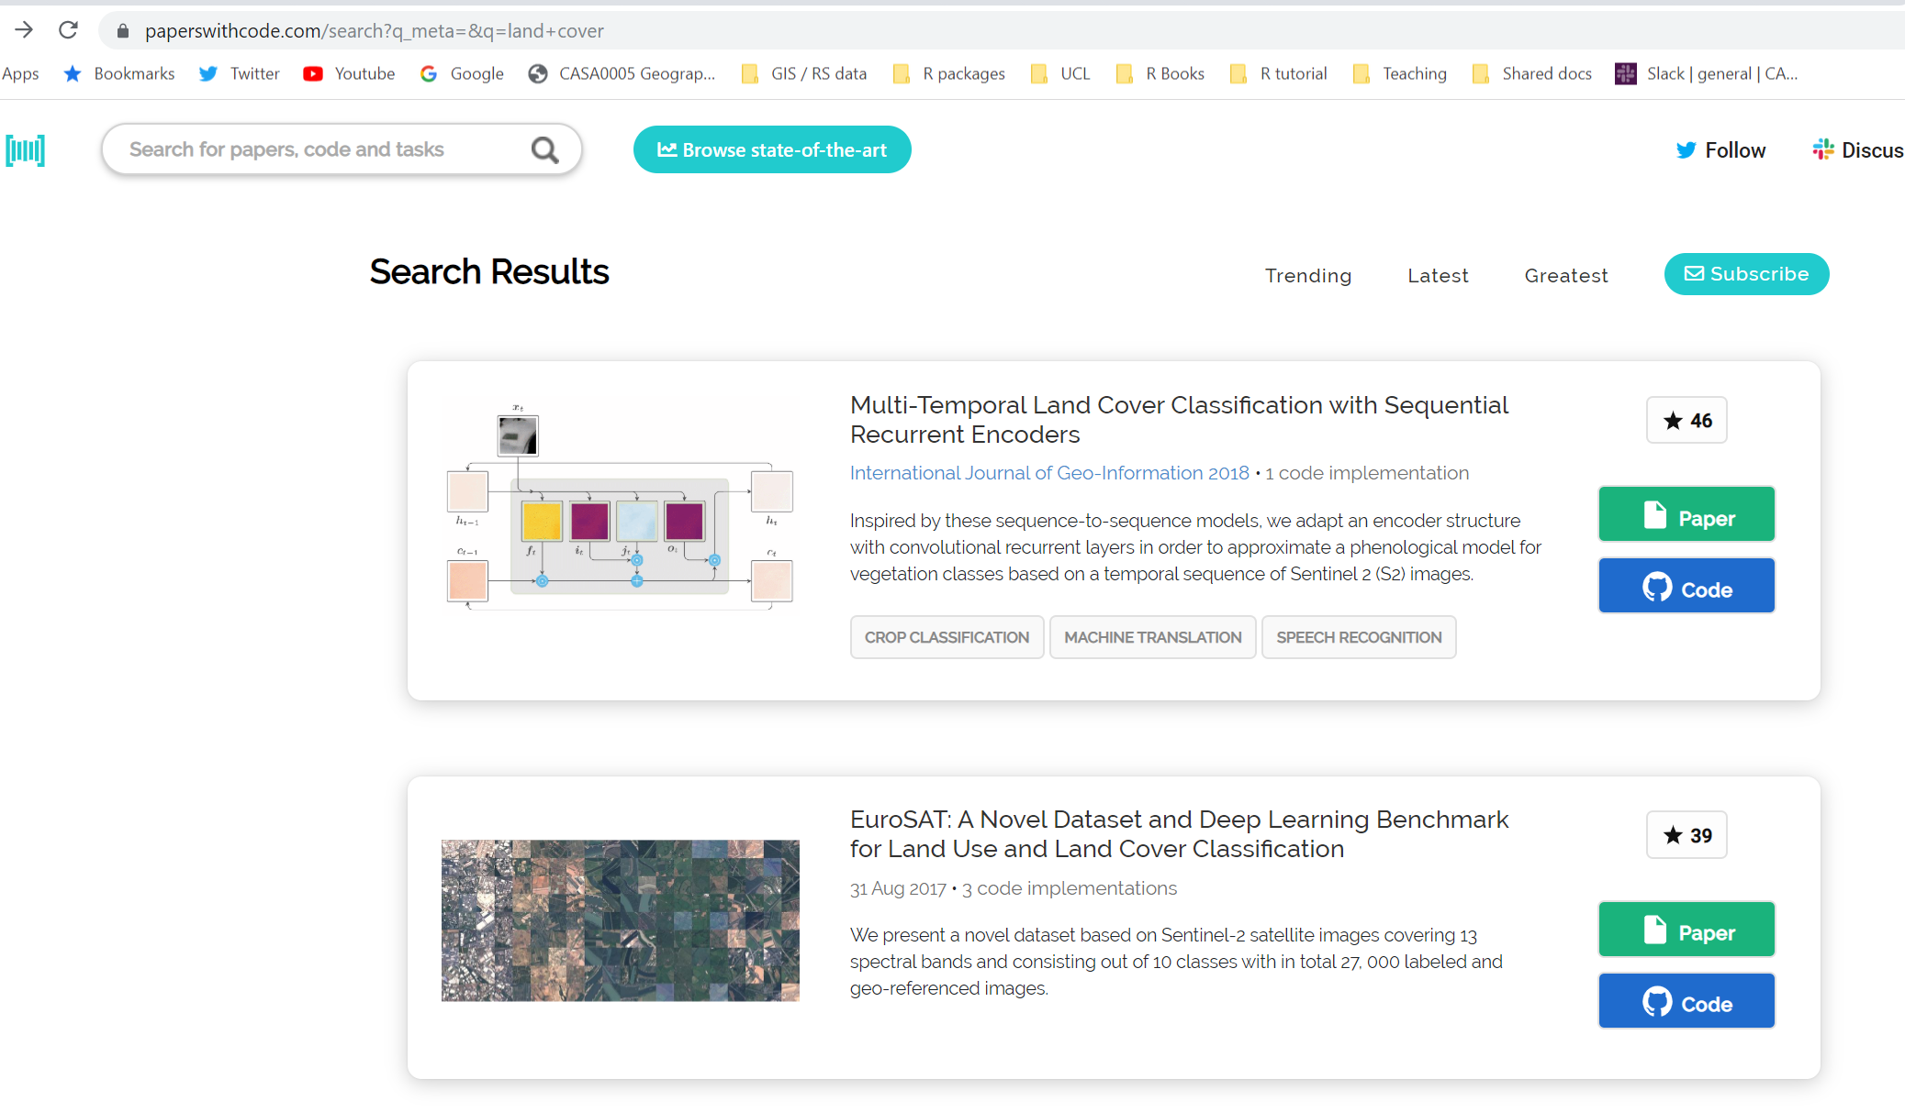
The future…it’s happening now..ish

Slide 19


BUT…
We have the most amount of data ever
Methodological procedures are expanding
Unreproducible results
Data is being weaponised and misrepresented
Data is being polluted
Fake news

Slide 20
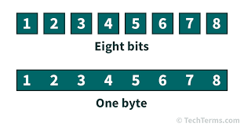
For 2017, 90% of the data in the world today has been created in the last two years alone, at 2.5 quintillion bytes of data a day! - IBM
Quintillion = a thousand raised to the power of six (1018)

Slide 21
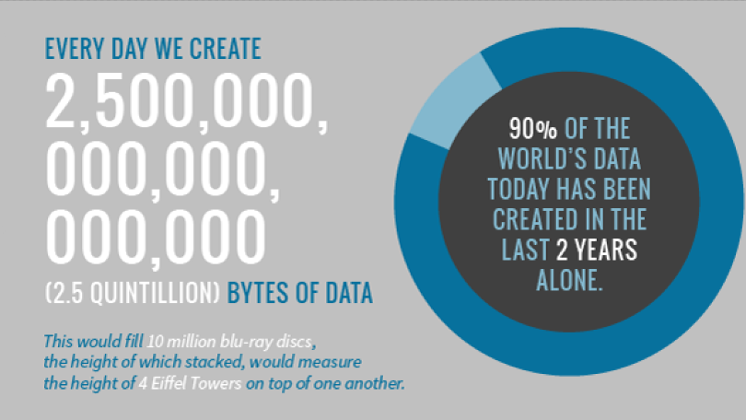

Slide 22
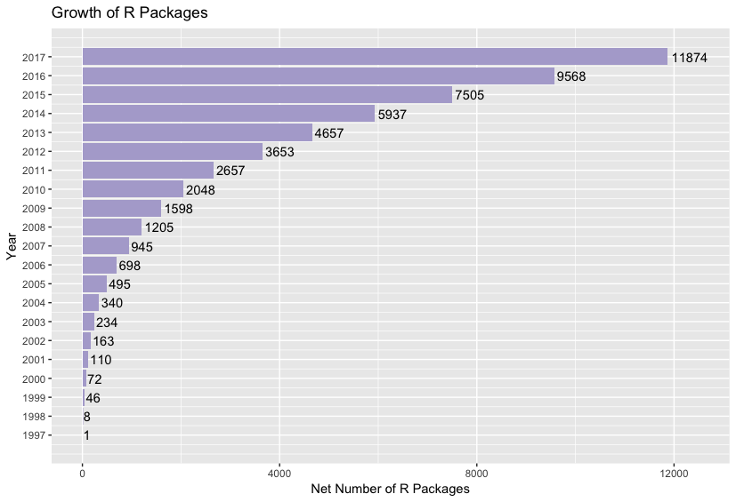

Slide 23
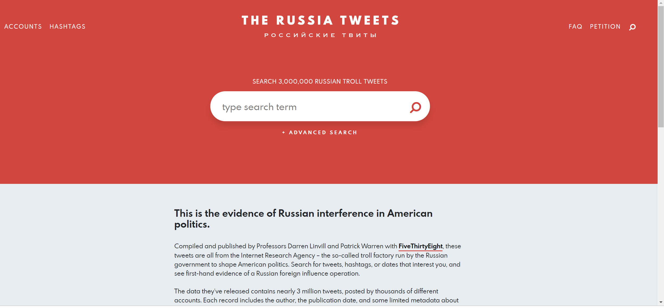
The Internet Research Agency’s influence operation seems to have had multiple goals (none of which was internet research). Its accounts amplified political voices on the far-Left and far-Right, making it seem as though Americans were much angrier and more polarized than they are. They promulgated reports of disasters that never happened. They pushed perspectives and news stories that favored the Russian government. Sometimes, they just tweeted out real news stories or played harmless games. Overall, the effect was to give the Russian government more control over social media, both within its own borders and around the world.

Slide 24
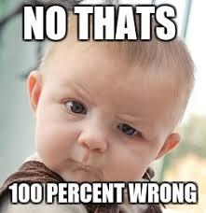
Amgen
Looked at 53 landmark cancer research studies
Findings only confirmed in 6 (11%)
Begley and Ellis (2012) Raise standards for preclinical cancer research, Nature

Slide 25
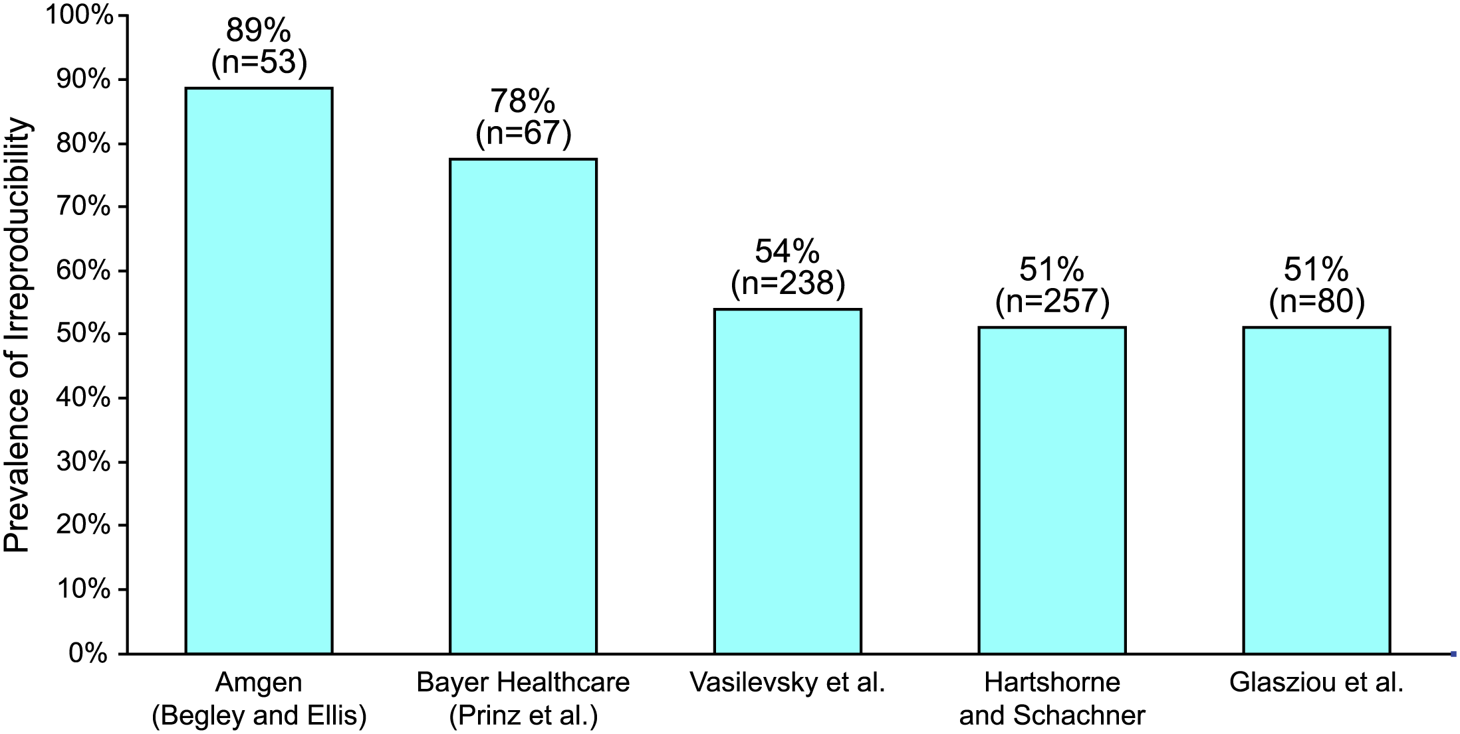
The Economics of Reproducibility in Preclinical Research
Irreproducible research > 50%
USD$ 28 billion spent on preclinical research that is not reproducible per year
Freedman et al. (2015) The Economics of Reproducibility in Preclinical Research, PLOS

Slide 26
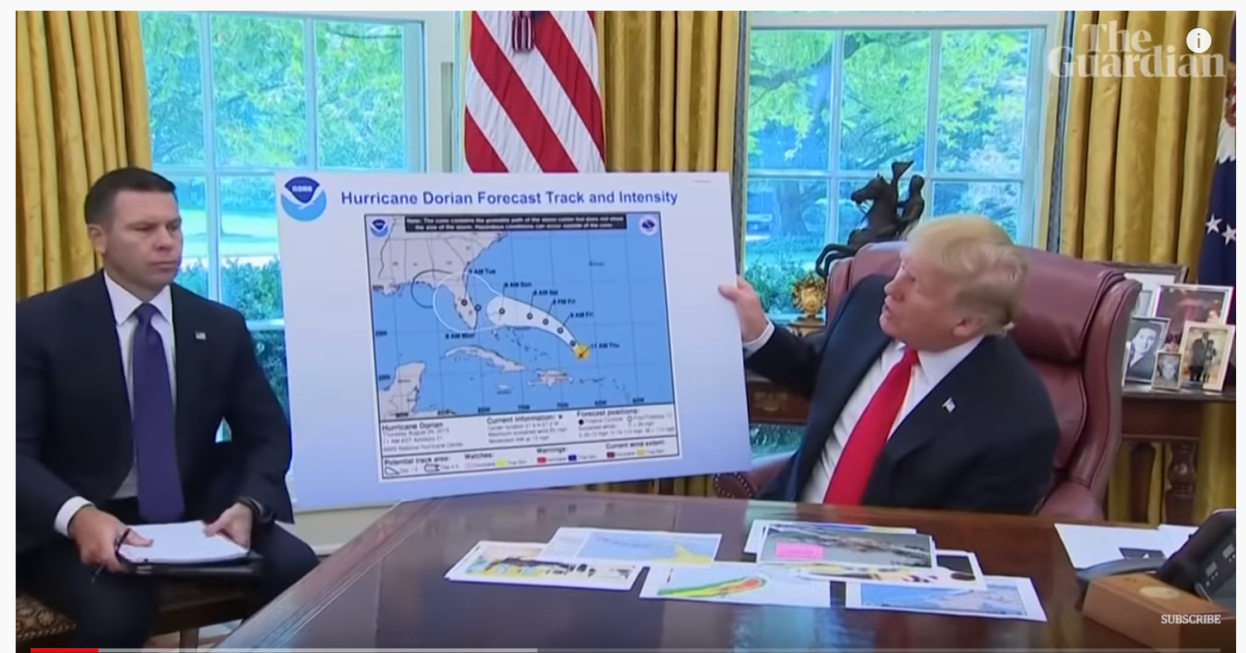
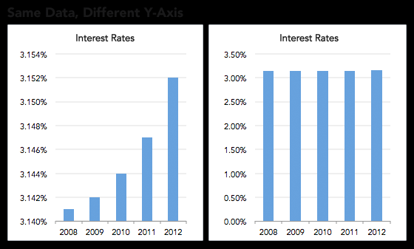

Fake news / reporting / trusted sources
"The UK has never sent, given or provided £350 million a week to Europe”
Data is being misrepresented
How reliable is the IPCC report

Slide 27
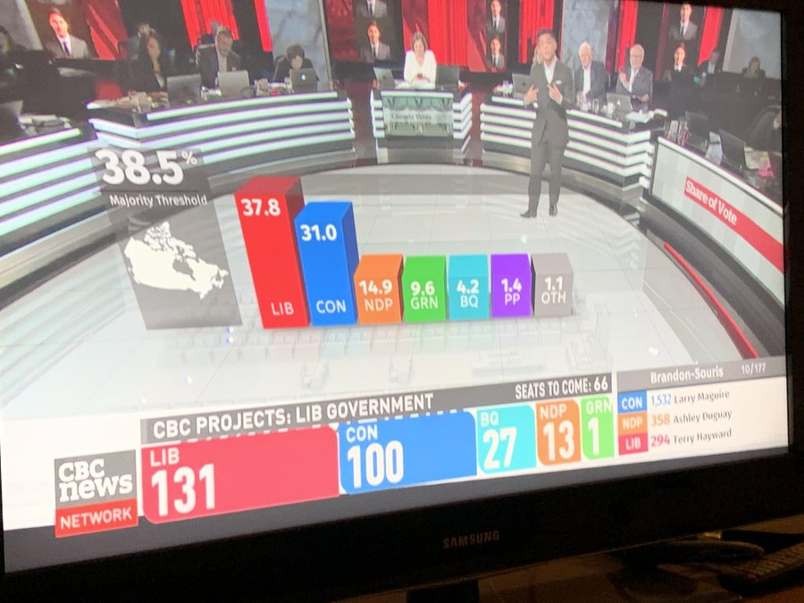
Fake news / reporting / trusted sources
What’s wrong with this from the last Canadian election

Slide 28
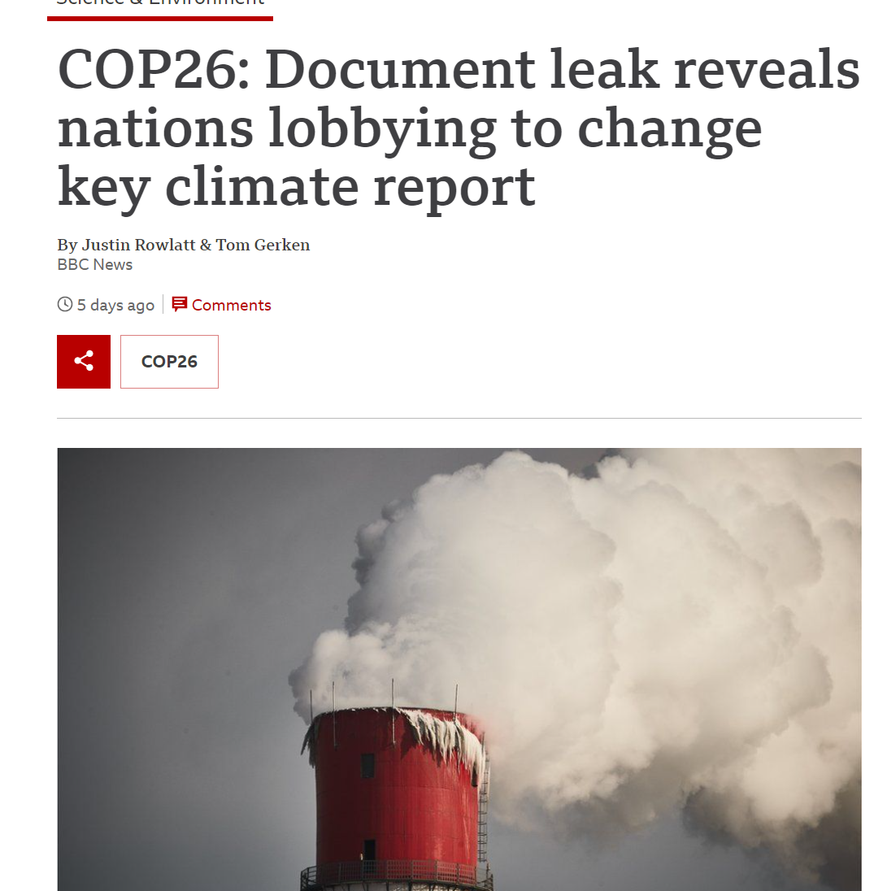
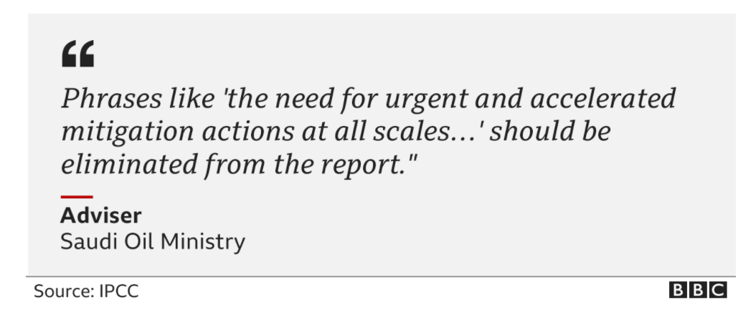
Hidden (or not so hidden) agendas
Government pressure
“One senior Australian government official rejects the conclusion that closing coal-fired power plants is necessary, even though ending the use of coal is one of the stated objectives the COP26 conference”

Slide 29

Fake news / reporting / trusted sources/ agendas
Mass of data
More methodological procedures
Data pollution
Low reproducibility
Misrepresentation of data potential

Slide 30
Conducting Reproducible Research
Guards against
Academic fraud
Erroneous interpretation
Allows for
Independent verification through transparency
Critique of methods
Critique of results
Promotes
New techniques
Good scientific practice

Slide 31
Conducting Reproducible Research
Decisions being made by AI? Data science? People? Bias? Unconscious bias?
BUT….
Where has the data come from
Who collected it and for what purpose
What was their agenda
Were the spatial areas representative of the population
Who wrote the software
What are the consequences of manipulating data or methods?

Slide 32
Conducting Reproducible Research
Be critical of the data, methods and outputs
This is part of the exam
Next slides will give a series of examples

Slide 33
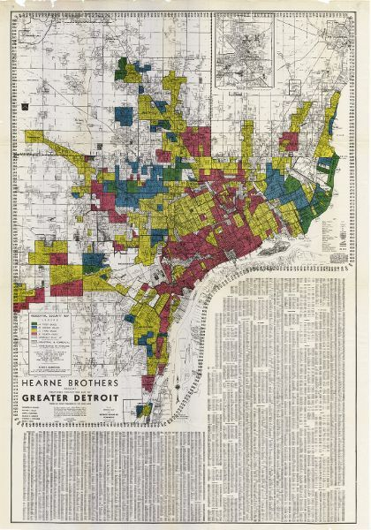
Conducting Reproducible Research – data bias?
Redlining
1930s – American Home Owner’s Loan Corporation – prevent missed payments
Divided places based on race
Social equity issues remain to this day
Illegal since 1968 Fair Housing Act
Who was responsible for this? All white, all male panel – Detroit Chamber of Commerce and Federal Home Loan Bank board
Catherine D'Ignazio and Lauren Klein (2020)

Slide 34
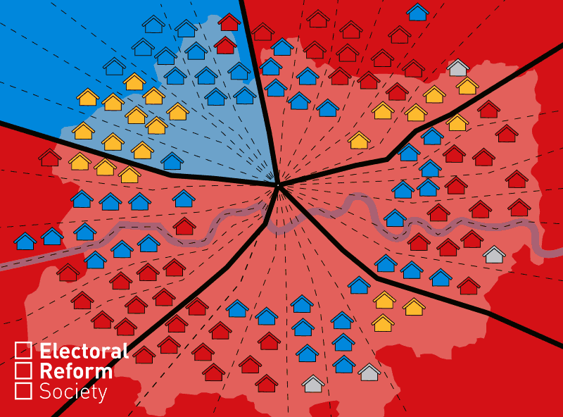
Conducting Reproducible Research – data bias?

Slide 35
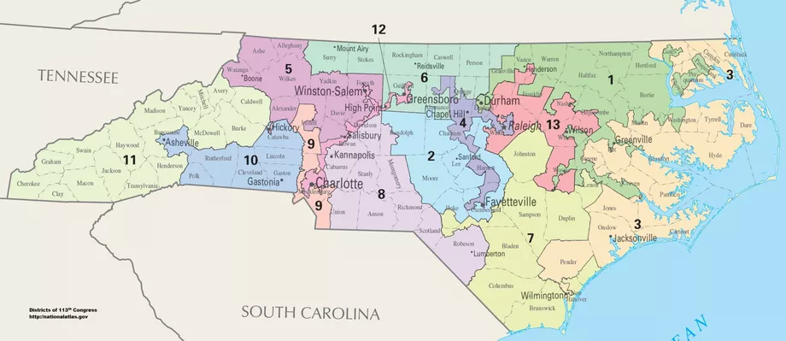
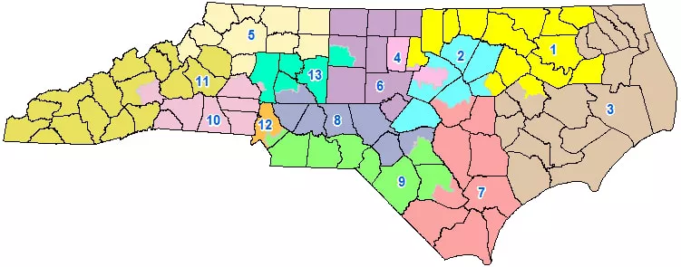
Conducting Reproducible Research – data bias?
Gerrymandering
Every 10 years electoral districts are re-drawn “redistricting”– Thomas Hofeller (republican) = PACK and CRACK
2011 redraw state congressional districts for North Carolina
District 12 – racial gerrymandering
State senate districts there were cracked – Greensborough, Winston Salem + Charlotte
Republicans took power + legislation = DANGER
Federal courts - 2016/2017 by republicans was racial gerrymandering. Redraw the lines without race. Looked at areas that voted for each part – partisan (party) gerrymandering – cracked Greensborough into 2 districts
In case 1 Greensborough (democrat) was packed in 2 it was cracked.
Multiple cases over 50% of voters for democrat BUT representation meant less than 50%. Congress = 48% votes to 23% seats
2019 – supreme court said it wasn’t their job. Left state to rule. Found it violated state constitution. Must redraw! Approve by legislators
Representatives are selecting voters! Not the other way around?
https://www.youtube.com/watch?v=KpamjJtXqFI

Slide 36
Conducting Reproducible Research - blackbox
“All of the implementations were tested with the same input data. They all gave the same results except the ESRI/ArcGIS implementation (Li 2018), and although ESRI provide help for the GWR tools, the actual coding is closed—the underlying code is not revealed” Brunsdon and Comber, 2020
Reproducible research isn’t just about the code we write or the analysis we do. The data we access is beyond our control but we must explore it critically.

Slide 37
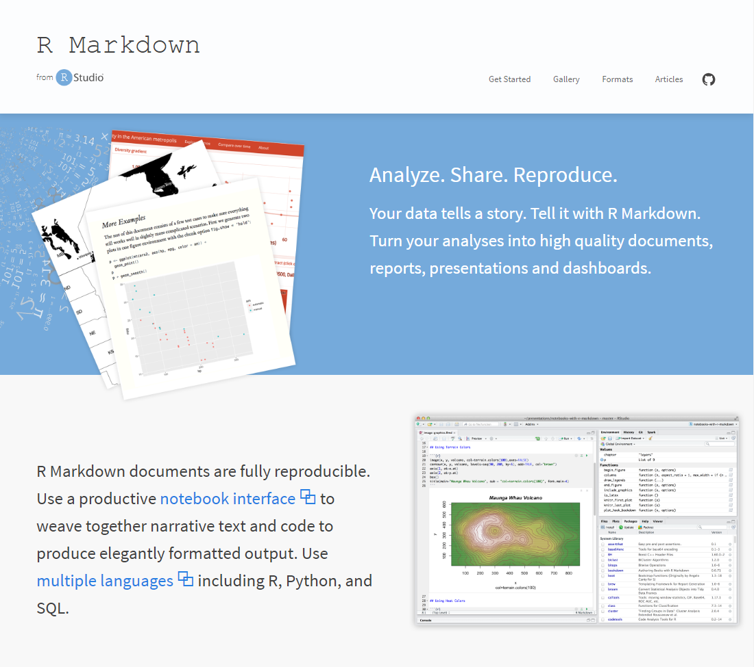
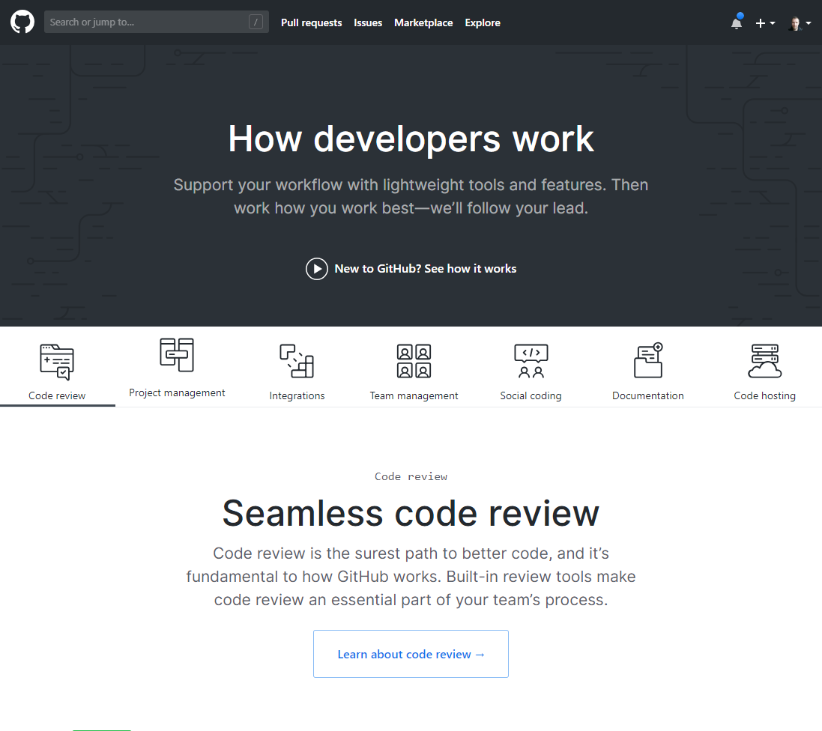
Conducting Reproducible Research…
How to we produce reproducible research?
Lots of different ways, but in Geographic Information / Spatial Data Science, two tools – RMarkdown and Github – are making openness and reproducibility far more straightforward

Slide 38
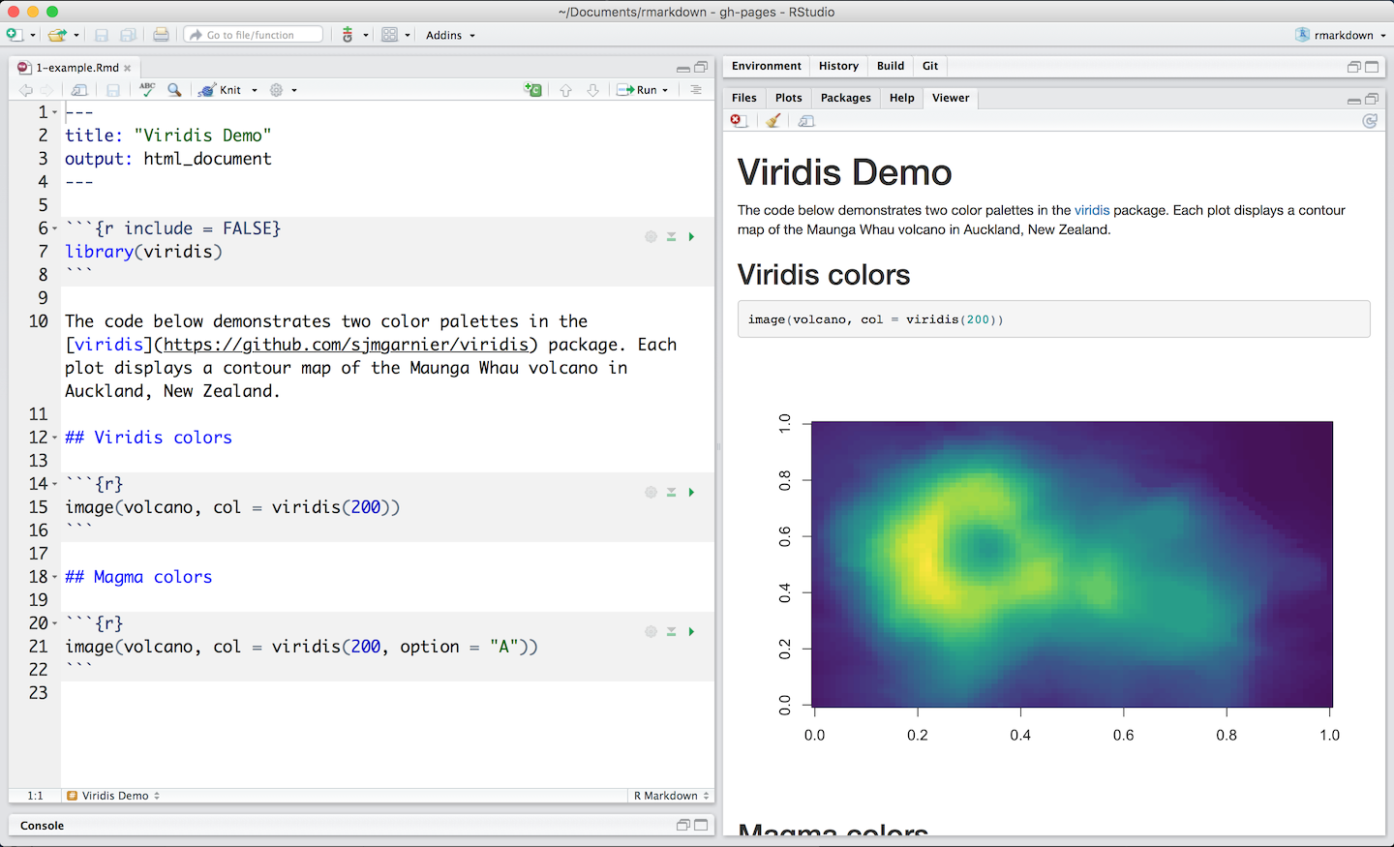
RMarkdown
RMarkdown documents enable the integration of text (commentary) with code and the outputs of that code.
RMarkdown documents can be ‘knitted’ into a range of different output formats
https://rmarkdown.rstudio.com/lesson-2.html

Slide 39
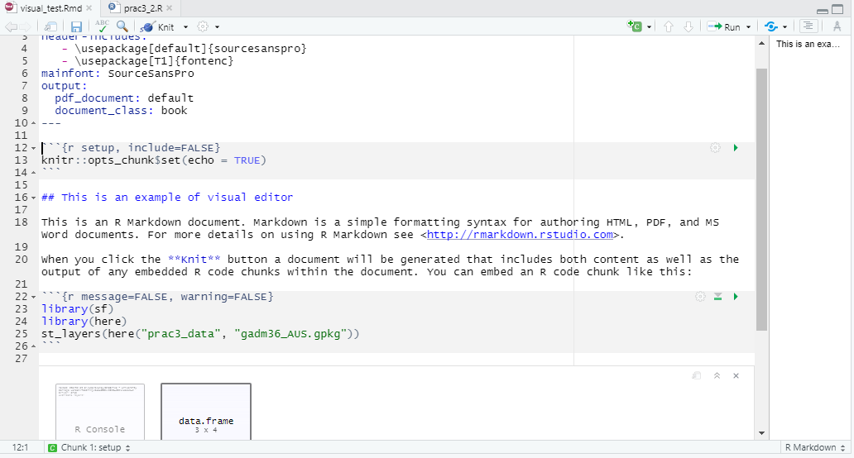
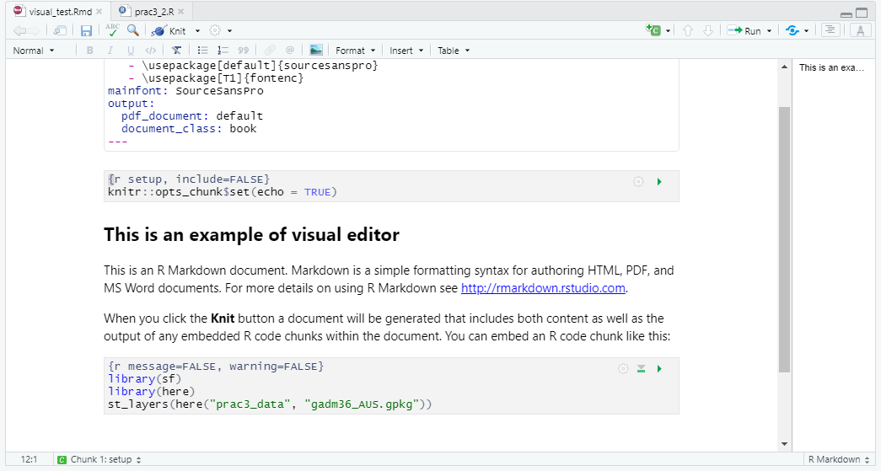
New Rmarkdown visual editor
With the recent release of version 1.4.9 there is a new visual RMarkdown feature
Basically moving towards a word style format with the option of code

Slide 40
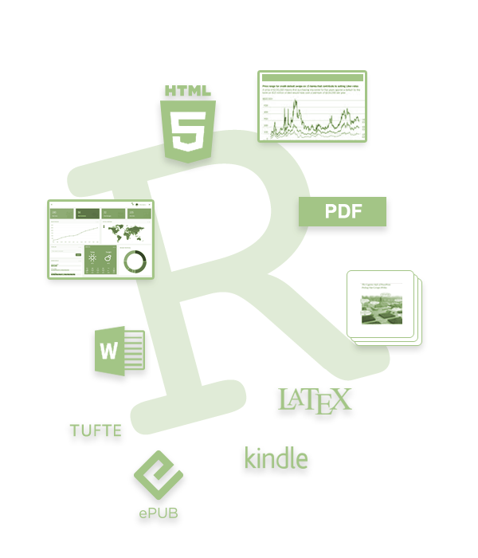
RMarkdown – Output Formats
HTML – Webpages
PDF documents
MS Word Documents
Books (see bookdown.org)
Scientific Papers formatted to particular journal styles
Slide-decks
Interpretive Dance*
*doesn’t actually output to interpretive dance - yet

Slide 41
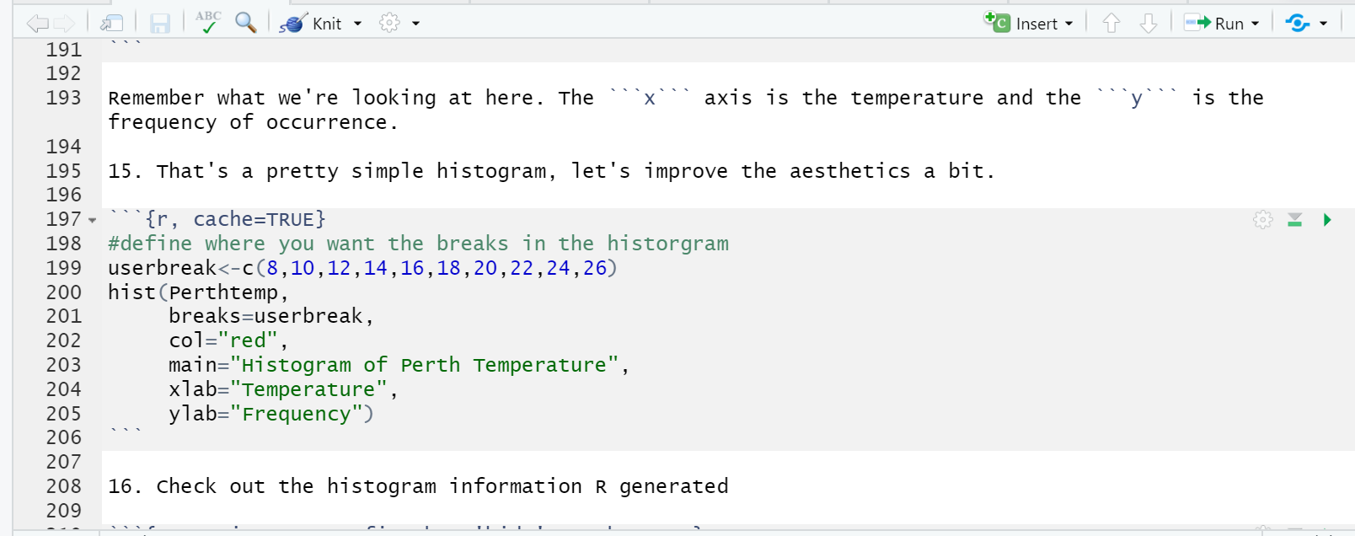
RMarkdown – Reproducibility Built In
Analysis and commentary are integrated so it is possible to describe the full workflow from data import > processing > analysis > results > interpretation/conclusions.
Anyone viewing your RMarkdown document will be able to reproduce exactly what you have done and through the commentary, understand how and why you have done it.

Slide 42
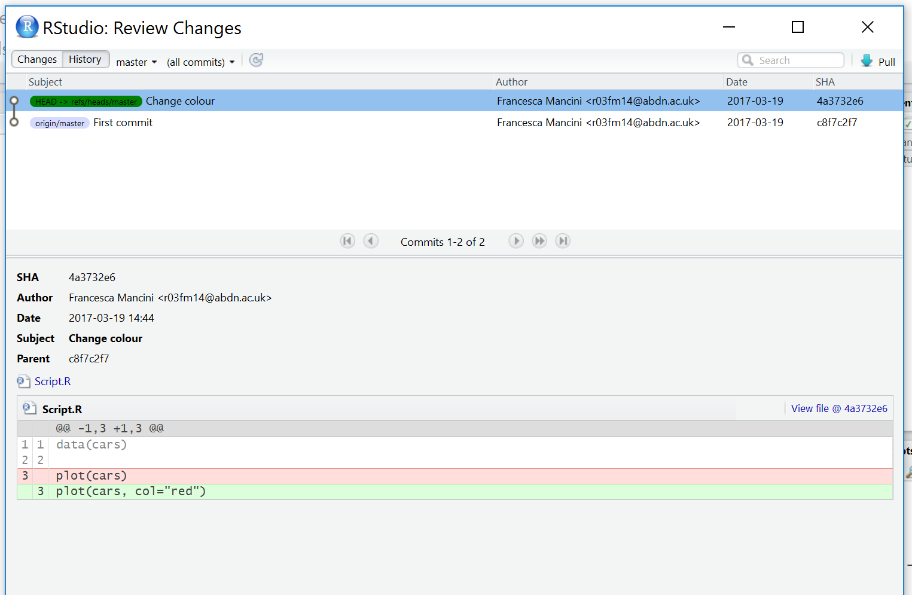
RMarkdown – Reproducibility Built In
It’s ASCII text so we can see the differences over time…

Slide 43



Terms
RStudio is a graphical user interface
RMarkdown is a version of the Markdown markup language which enables plain text to be formatted to contain links to data, code to run, text to explain what you a producing and metadata to tell your software what kinds of outputs to generate from your markdown code
Git is a software version control system which allows you to keep track of the code you produce and the changes that you or others make to it. It needs installing.
GitHub is an online repository that allows anyone to view the code you have produced (in whatever language you choose to program in) and use/scrutinise/contribute to/comment on it

Slide 44
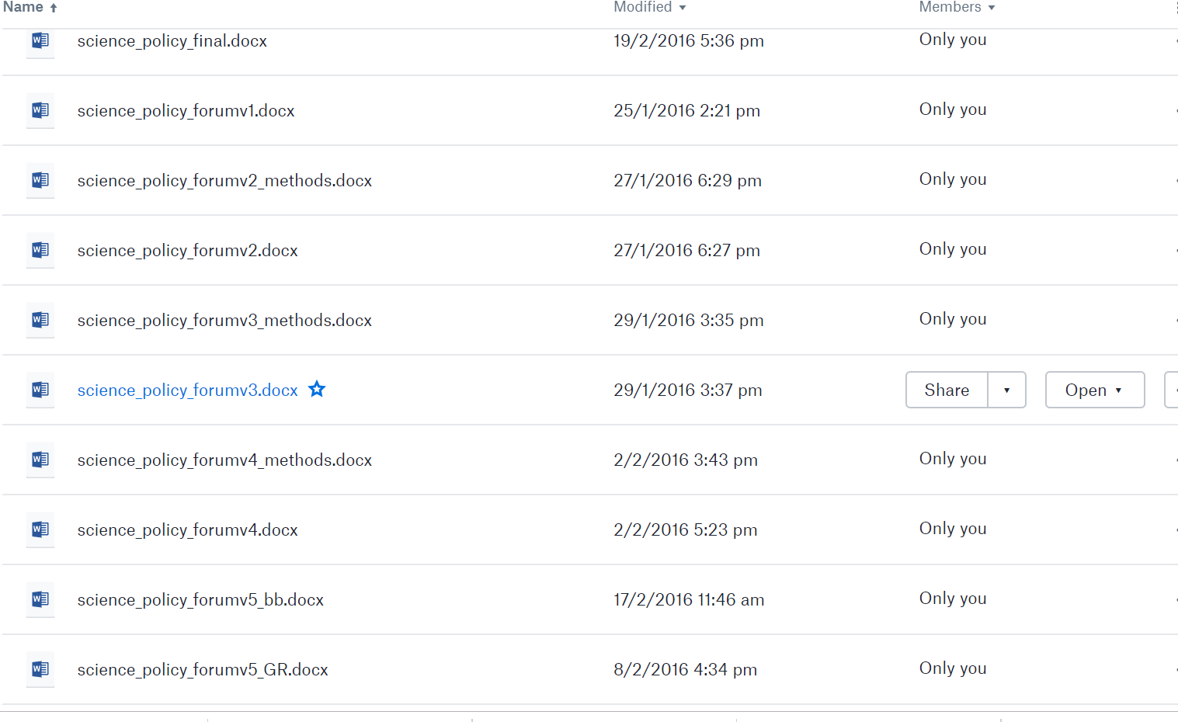
Git

Slide 45
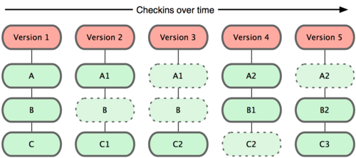
Git
A git repo = folder that tracks changes
You have three files A B and C
Git takes a snapshot every time you commit
If nothing changes it just uses the same one as before
It knows where the changes are

Slide 46
Git
Stage – prepare files to commit (checks for changes)
Commit – put them in my folder
Push – put them online…to GitHub

Slide 47
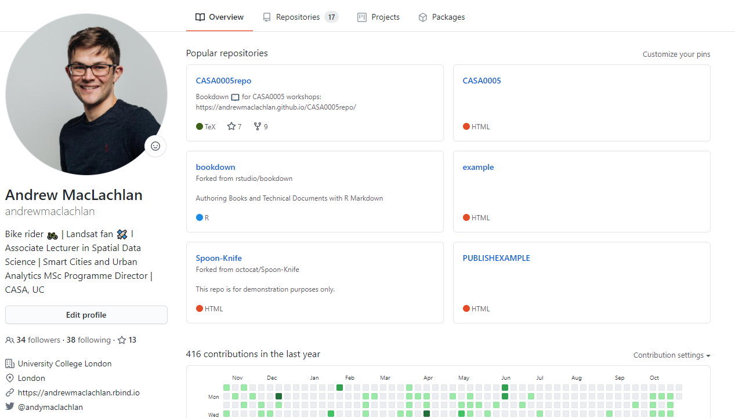
GitHub
An online hosting service for Git repositories

Slide 48
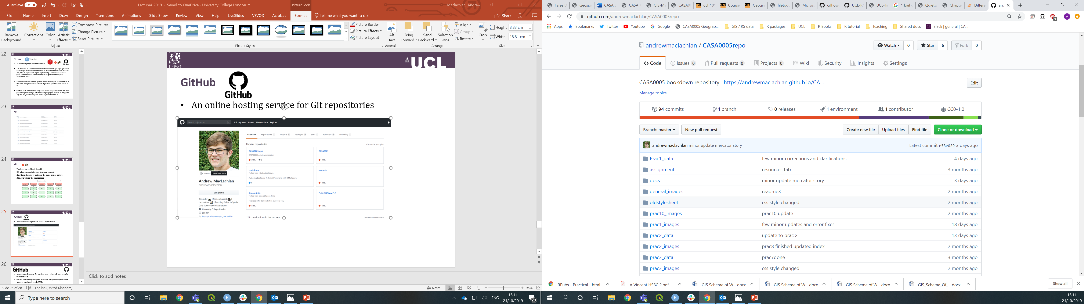
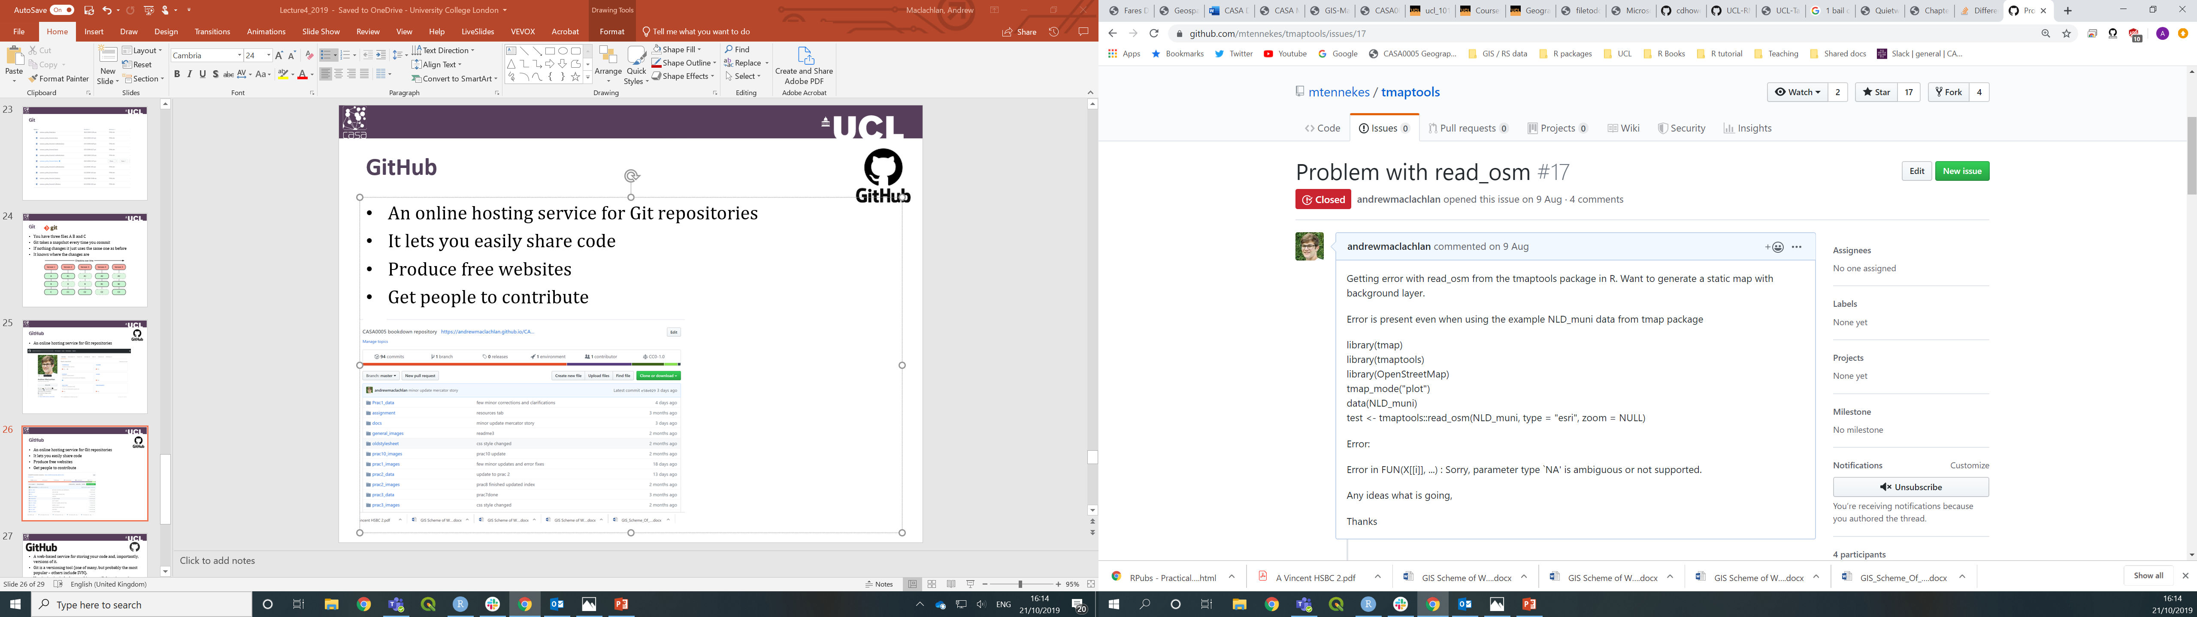
GitHub
An online hosting service for Git repositories
It lets you easily share code
Produce free websites
Get people to contribute and raise issues / improve code

Slide 49
Practical this week
This week’s practical will cover how to use:
Git – in R
GitHub – in R
RMarkdown
It’s important as we will use in the exam! It’s how you will submit your work
Before tomorrow watch Git for Humans by Alice Bartlett

